Slide 1
Rust Programing Language
Berk Pekşen
Notes:
ID=d924773e-9a16-4d6d-9803-8cb819e99682 Recipe=text_billboard Type=TextOnly Variant=0 FamilyID=AccentBoxWalbaum_Zero

Slide 2

Rust:
Rust is a systems programming language that focuses on safety and performance.
Created by Mozilla Research, first released in 2010.
Designed to prevent memory errors and ensure thread safety.
Commonly used for programming, web assembly, and game development. system-level

Slide 3
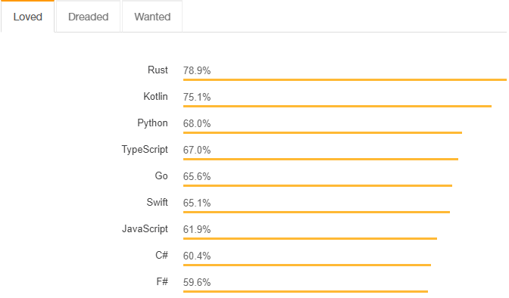
Most Loved Languages
https://survey.stackoverflow.co/2018

Slide 4


Key Features of Rust
Memory Safety: Rust's ownership system ensures memory safety without a garbage collector.
Concurrency: Fearless concurrency, preventing data races at compile-time.
Performance: Comparable to C and C++ in speed and efficiency. Zero-Cost
Package Manager: Cargo for managing dependencies and building projects.

Slide 5
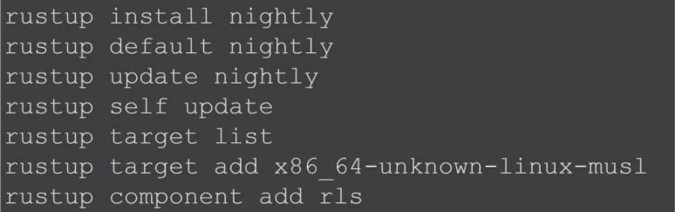
Instolation
Arch Linux: pacman -S rustup
Unix: curl https://sh.rustup.rs -sSfl Sh
Windows: download and run the rustup-init.exe (Requires Microsoft C++ Build Tools)

Slide 6
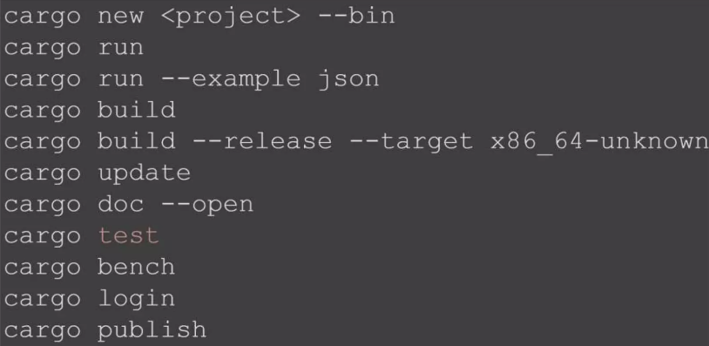
Build

Slide 7
Comparison

Slide 8
Rust vs. C
Memory Management:
Rust: Ownership, borrowing, and lifetimes.
C: Manual memory management with malloc/free.
Performance:
Both languages offer high performance, but Rust often catches errors at compile-time that would be runtime errors in C.

Slide 9
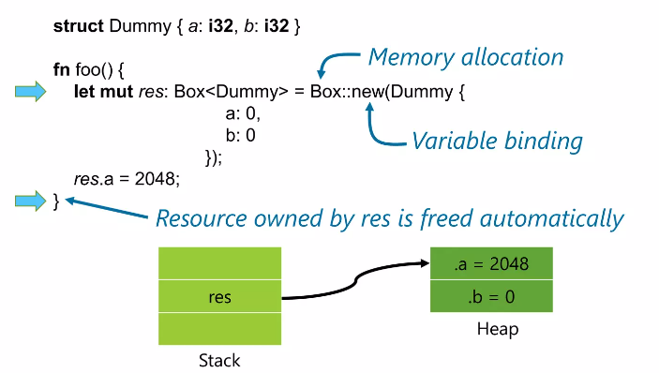
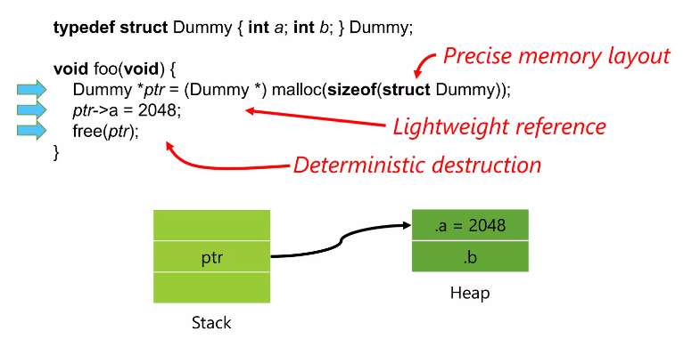
Memory:
C
Rust

Slide 10
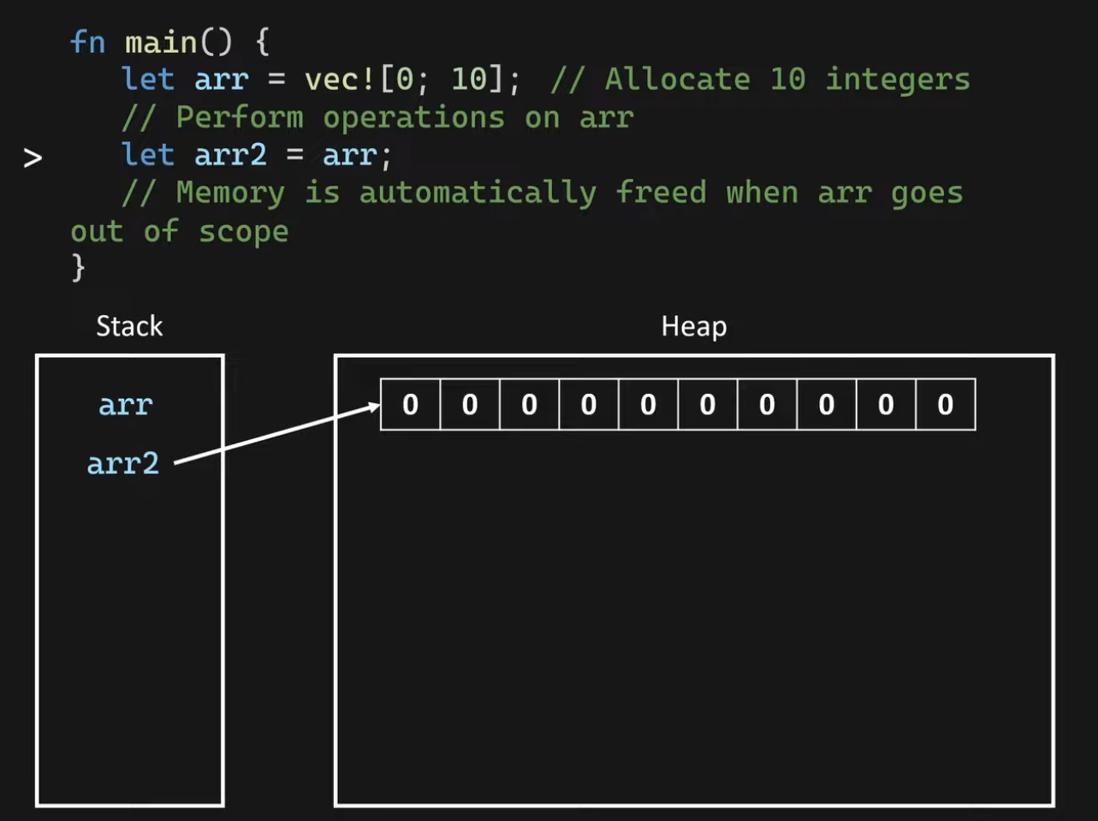
Rust

Slide 11

Rust vs. Python
Type System:
Rust: Statically typed.
Python: Dynamically typed.
Memory Management:
Rust: No garbage collector, uses ownership and borrowing.
Python: Automatic memory management with garbage collection.
Use Cases:
Rust: System-level programming, performance-critical tasks.
Python: Rapid development, scripting, data analysis.

Slide 12
Testing

Slide 13
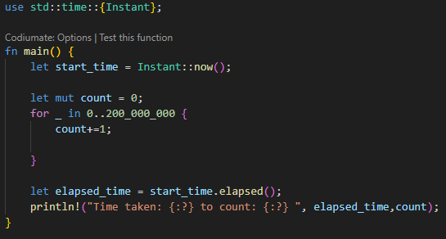
200M Loop

Slide 14
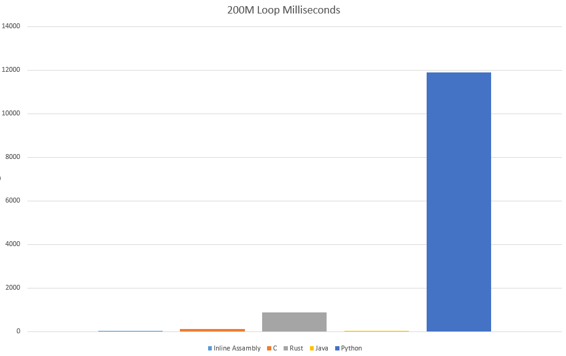
200M Loop

Slide 15
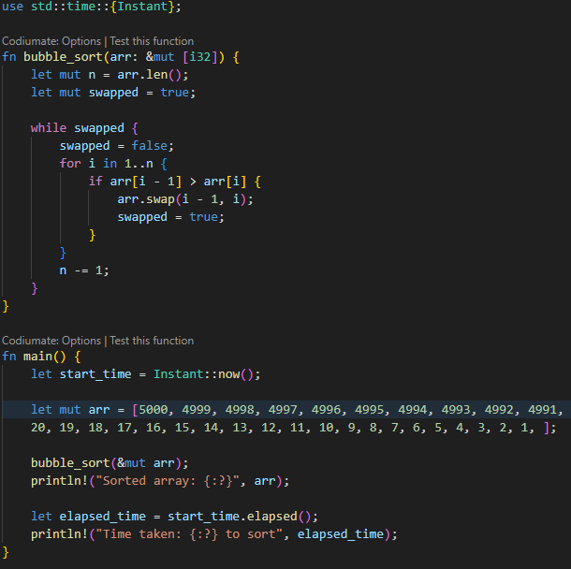
BubbleSort

Slide 16
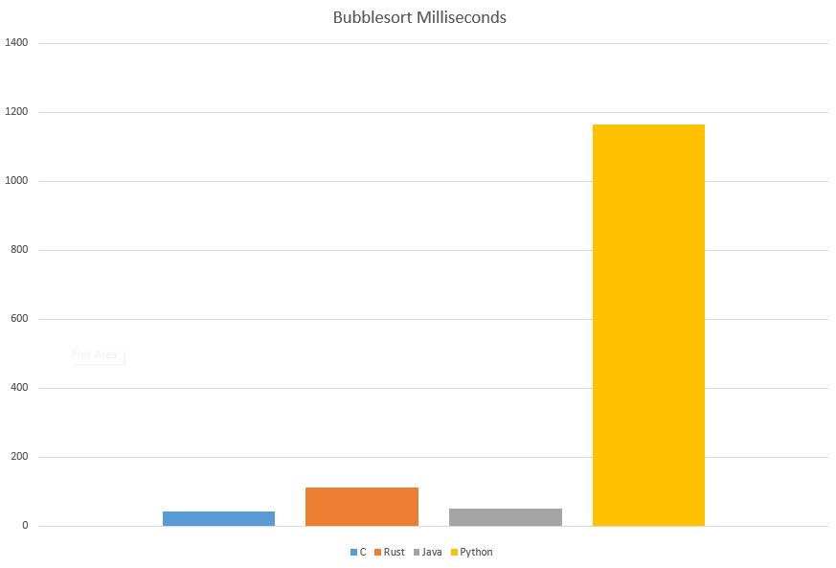
BubbleSort

Slide 17
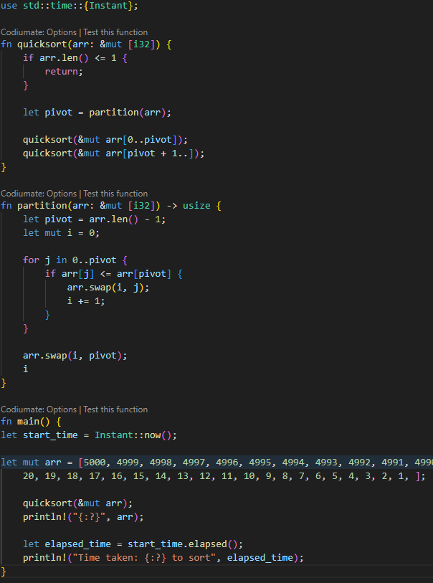
QuickSort

Slide 18
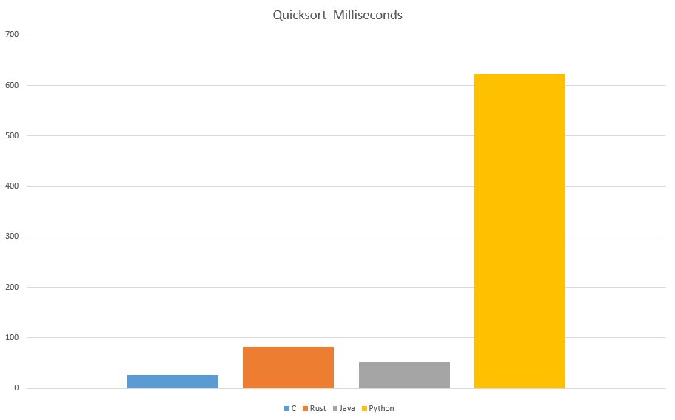
QuickSort

Slide 19
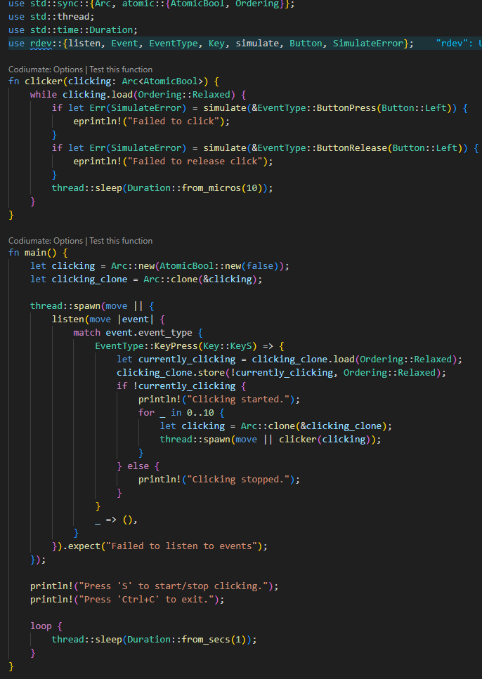
Traveling Salesman Problem(Brute Force)

Slide 20
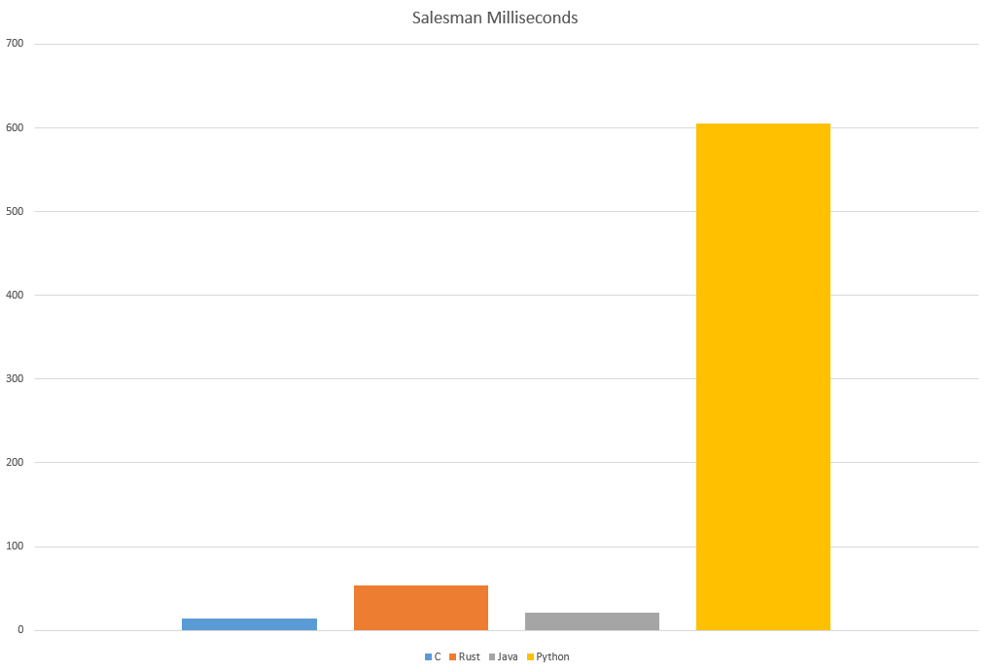
Traveling Salesman Problem

Slide 21
More Professional Testing
https://github.com/PlummersSoftwareLLC/Primes
https://plummerssoftwarellc.github.io/PrimeView/?rc=30&rs=0&fr=&sc=dt&sd=True

Slide 22
Thank you

Slide 23
Relevant Links
https://doc.rust-lang.org/book/
https://doc.rust-lang.org/book/ch01-01-installation.html
https://www.rust-lang.org/tools/install
https://visualstu
https://doc.rust-lang.org/cargo/commands/cargo.htmldio.microsoft.com/visual-cpp-build-tools/

